Slide 1


Systems Analysis and Design with UML
Alan Dennis, Barbara Wixom, and David Tegarden
Chapter 8: Behavioral Modeling
John Wiley & Sons, Inc.
Copyright 2010

Slide 2
Key Ideas
Behavioral models describe the internal dynamic aspects of an information system that supports business processes in an organization
Key UML behavioral models are: sequence diagrams, collaboration diagrams, and statechart diagrams

Slide 3
Objectives
■ Understand the rules and style guidelines for sequence and communication(collaboration) diagrams and behavioral state machines.
■ Be able to create sequence and communication diagrams and behavioral state machines.
■ Understand the relationship between the behavioral models and the structural and functional models.

Slide 4
UML Diagrams
Interactions
Viewpoint
Functional
viewpoint
Sequence Diagram
Communication Diagram
Timing Diagram
Interaction Overview
Diagram
Use Case
Diagram
Component Diagram
Package Diagram
Class Diagram
Object Diagram
Deployment Diagram
Composite Structure
Diagram
State Machine Diagram
Behavioral
Protocol
Activity Diagram
Structural
viewpoint
Behavioral
viewpoint

Slide 5
Purpose of Behavioral Models
Show how objects collaborate to support each use case in the structural model
Depict the internal view of the business process
To show the effects of varied processes on the objects in the system

Slide 6
Interaction Diagram Components
Objects
Instantiation of a class
Has attributes that describe an object
Operations
Send and receive messages
Messages
Tell object to execute a behavior

Slide 7
Sequence Diagram

Slide 8
Sequence Diagrams
Illustrate the objects that participate in a use-case
Show the messages that pass between objects for a particular use-case

Slide 9
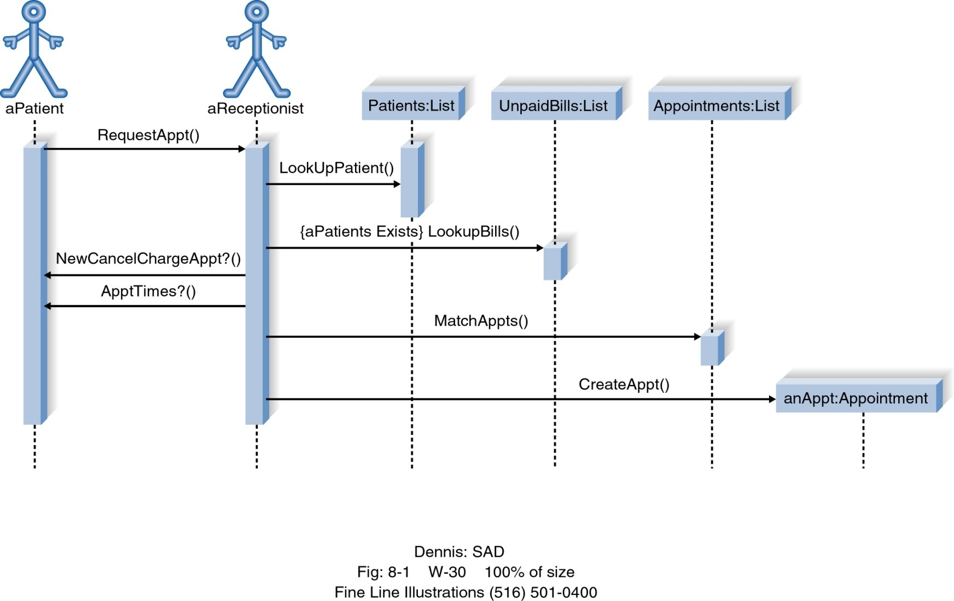
Example of Sequence Diagram

Slide 10
Sequence Diagram Syntax
AN ACTOR
AN OBJECT
A LIFELINE
A FOCUS OF CONTROL
A MESSAGE
OBJECT DESTRUCTION
anObject:aClass
aMessage()
x

Slide 11
Sequence Diagram의 표기법 (1)
Register
Sale
object
message
msg1()
timeline
msg2()
Activation
Box
msg3()
msg4()
msg5()

Slide 12
Sequence Diagram의 표기법 (2)
Register
Sale
msg1()
msg2()
msg3()
Return
arrow
msg4()
clear()
self message

Slide 13
Sequence Diagram의 표기법 (3)
Register
Sale
Object
Creation
msg2()
create()
Payment
authorize()
delete()
Object
Destruction
X

Slide 14
CD Selections
Normal Flow of Events:
1. Customer submits a search request to the system.
2. The system provides the customer a list of recommended CDs.
3. The customer chooses one of the CDs to find additional
information.
4. The system provides the customer with basic information &
CD Reviews
5. The customer calls the maintain order use case.
6. The customer iterates over 3 through 5 until finished shopping.
7. The customer executes the checkout use case.
8. The customer leaves the website.

Slide 15
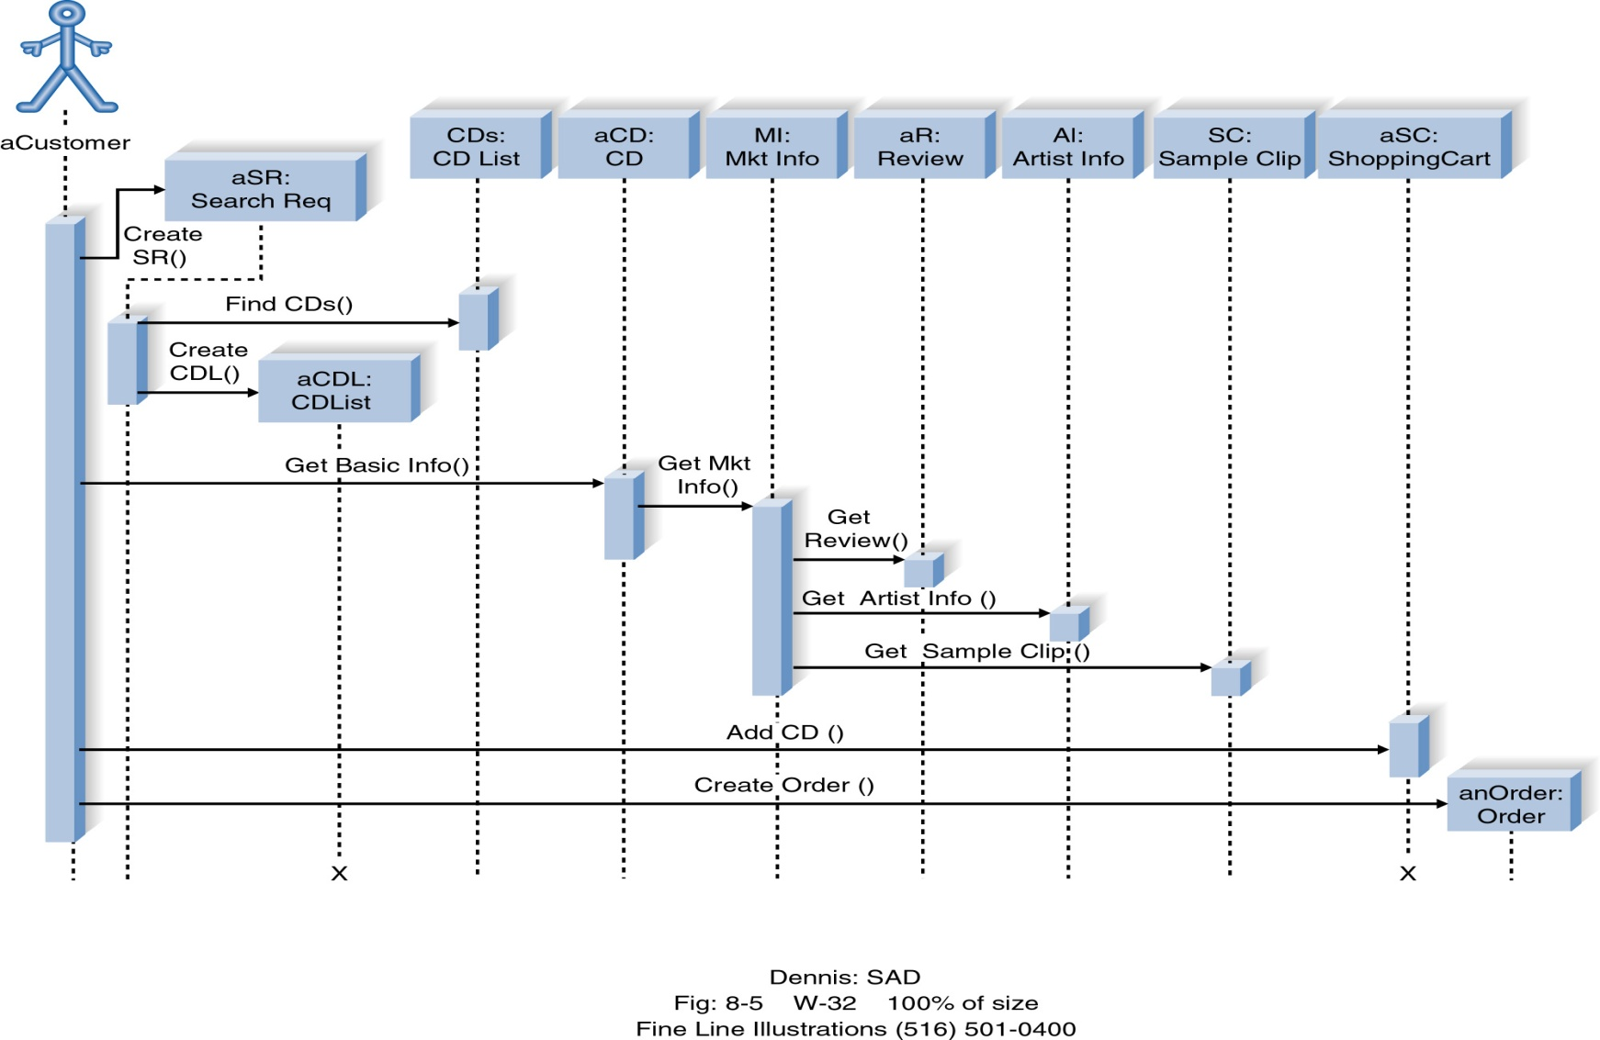
CD Selections
Object
Creation
Object
Destruction

Slide 16
Combined Fragments of UML2.0
alt : alternatives
par : parallel
loop : loop
critical : critical region
assert : assertion
opt : option
neg : negative : invalid trace
etc

Slide 17
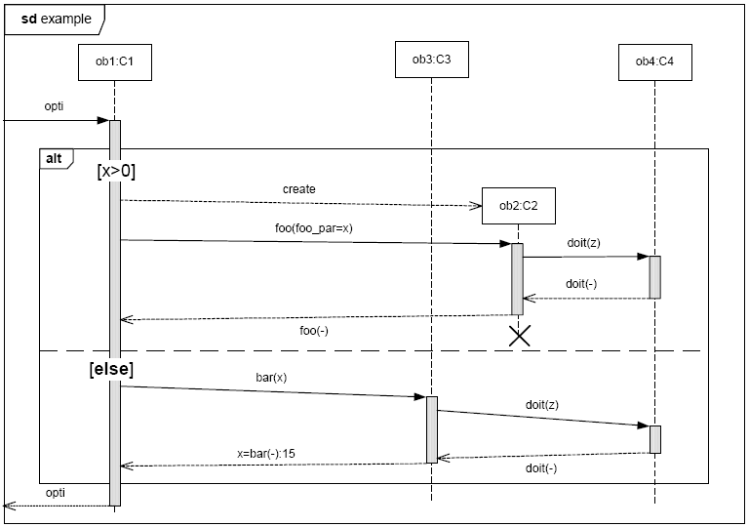
Examples of Combined Fragments

Slide 18
Interaction Use
is a shorthand for copying the contents of the referred Interactions

Slide 19
Timing Constraints

Slide 20
Message Kind
code
Asynchronous message
Call message
Reply message
Lost message
Found message
doit(z)

Slide 21
Pitfalls in Sequence Diagram I
■ 표기법 정확하게
AN OBJECT
A LIFELINE
Focus Control
anObject:aClass
anObject
code
Asynchronous message
Call message
Reply message
doit(z)

Slide 22
Pitfalls in Sequence Diagram II
■ Message Request
anObject1
anObject2
anO1
anO2
anO3
req_srv()

Slide 23
Pitfalls in Sequence Diagram III
회원관리
카드관리
자전거관리
사용자
관리자
2.회원등록
1.가입
3.등록완료
4.가입완료
5.카드발급요청
6.카드발급
8.카드지급
7.카드지급
자전거 사용
자전거제공

Slide 24
Pitfalls in Sequence Diagram IV
직원
Login
CookManagement
HallView
TotalManagement
Table
init()
init()
sendMsg()
ReceiveMsg()
init()
init()
sendMsg()
receiveMsg()

Slide 25
Collaboration Diagram (Communication Diagram in UML 2.0)

Slide 26
Collaboration Diagrams
Essentially an object diagram that shows message passing relationships instead of aggregation or generalization associations.
Emphasize the flow of messages among objects, rather than timing and ordering of messages

Slide 27
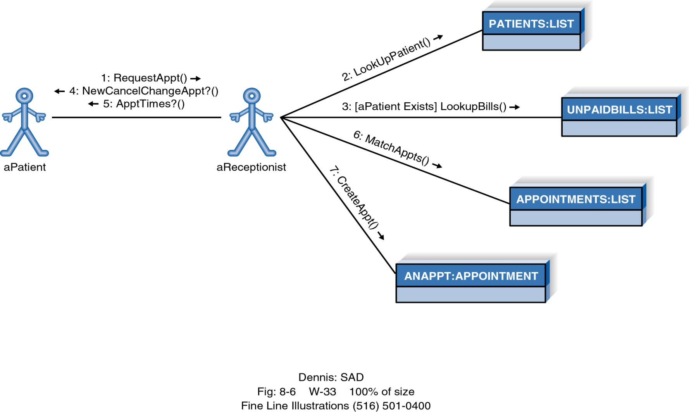
Example of Collaboration Diagram

Slide 28



Collaboration Diagram Syntax
Actor
Object
Association
Message
Frame

Slide 29
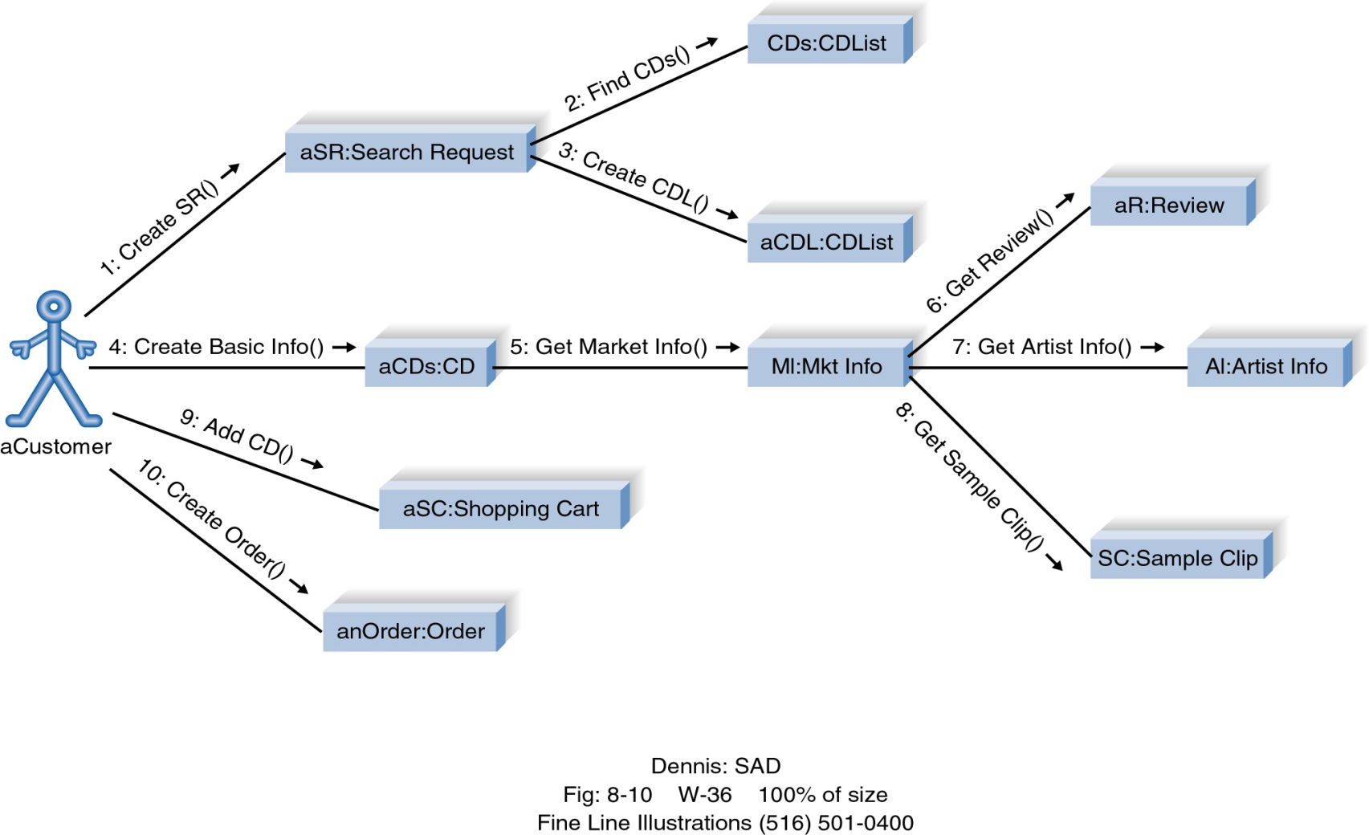
CD Selections

Slide 30
Verification of Class Model

Slide 31
Testing Class Diagram
Access paths
trace access paths through the model diagram
When a unique result is expected, see if the model will yield that result
think of questions that might be asked, see if the model answers them
For any questions that can not be answered, alter the model

Slide 32
Checking Symptoms
Signs of missing objects:
difficulty in generalizing cleanly: one class may play two roles
split it up
operation is good but there is not a good target class
add the missing target class
two associations with same name and purpose
create a super class that unites them
Signs of unnecessary classes:
lack of attributes for the class
lack of operations on the class
lack of associations on the class

Slide 33
Checking Symptoms II
Signs of missing associations include:
missing access paths for operations
add new associations
make certain that all queries can be answered
Signs of unnecessary associations:
same information in multiple associations
remove associations that do not add new information
lack of operations that go across the path of the association
If no operations need this association, the association may not be needed. Wait until operations are complete

Slide 34
Checking Symptoms III
Signs of incorrect placement of associations:
role names that are too broad or narrow for their class
move association up or down in the class hierarchy

Slide 35
Use Case Realization

Slide 36
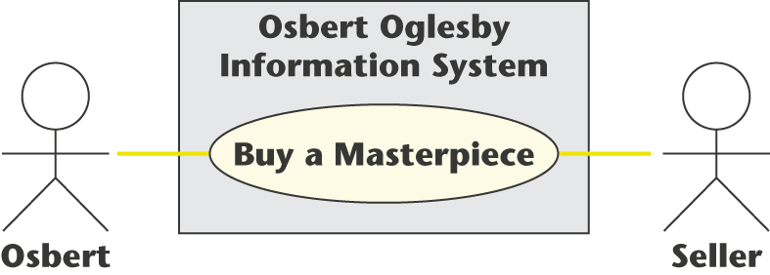
Use-Case Realization
The realization of a specific scenario of a use case is depicted using an interaction diagram
Either a sequence diagram or collaboration diagram

Slide 37
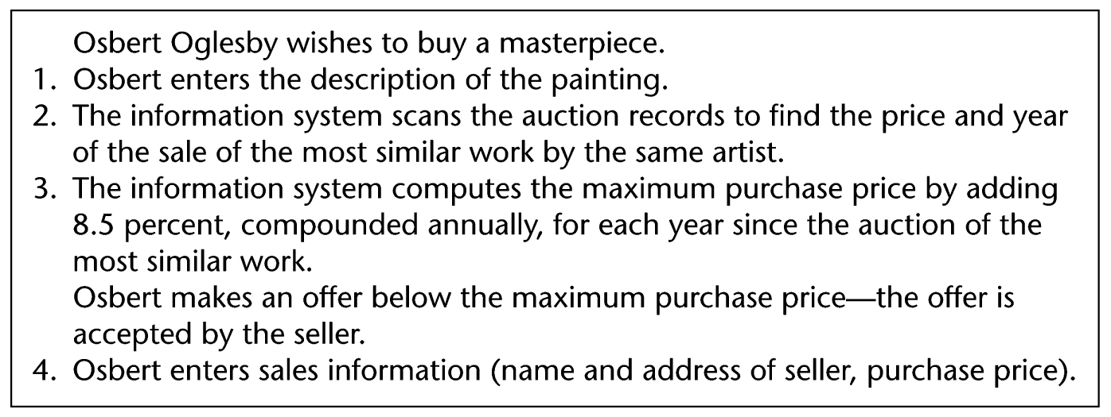
Buy a Masterpiece Use Case
Scenario (one possible instance of the use case)

Slide 38
Class Diagram related to UC
Class diagram (classes that enter into the use case)
The seller provides
data entered by Osbert
Seller
Masterpiece
Class
Osbert
User Interface
Class
Compute
Masterpiece
Price Class
Auctioned
Painting
Class

Slide 39
Realization by Communication Diagram
3: Create
new
object
11: Request
update
[new]
1: Give
masterpiece
details
9: Give
seller
details
: Masterpiece
Class
2: Transfer
masterpiece
details
10. Transfer
seller
details
4: Return
new
object
12: Send
acknowledg-
ment
8: Display
price
14: Display
acknow-
ledgment
7: Provide
price
13: Send
acknow-
ledgment
Osbert
: User Interface
Class
: Compute
Masterpiece
Price Class
5: Browse
auctioned
paintings
6: Return
auctioned
painting
Data that the
seller provides
for Osbert to enter
: Auctioned
Painting
Class
Seller

Slide 40
Realization by Sequence Diagram
: User
Interface
Class
: Compute
Masterpiece
Price Class
: Auctioned
Painting
Class
Seller
Osbert
Give masterpiece
details
Transfer details
: Masterpiece
Class
Create new object
Data that the
seller provides
for Osbert to enter
Return new object
Browse auctioned paintings
Return auctioned painting
Provide price
Display price
Give seller details
Transfer seller
details
Request update
Send acknow-
ledgment
Send acknow-
ledgment
Display acknow-
ledgment

Slide 41
State Machine Diagram

Slide 42
Behavioral State Machines
The behavioral state machine is a dynamic model
shows the different states of the object
shows what events cause the object to change from one state to another, along with its responses and actions.

Slide 43
Finite State Machine (FSM)
A finite state machine is a model of behavior composed of a finite number of states, transitions between those states, and actions
Classification
Acceptors (inputs)
Transducers (inputs → outputs)
Moore machine (output depends only on the state)
Mealy machine (output depends on input and state)
Finite State Machine consists of
A finite set of input symbols, Σ
A finite set of states, Γ
The starting state, S
A transition function,
(Input X State → State)
S
a
b
a
A
B
b

Slide 44
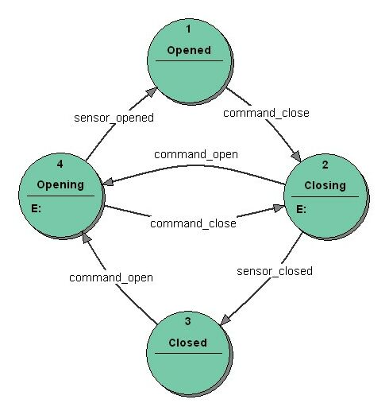
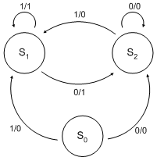
Examples of Moore and Mealy machines
<Moore Machine>
<Mealy Machine>

Slide 45
Example of Acceptors
numeric constants
S
s
d
d
d
A
B
$
•
d
d
$
A
E
F
e
$
Legend :
s = { +. - }
d = { 0, 1, 2, 3, 4, 5, 6, 7, 8, 9 }
Σ = {s, •, e, d, $}
F
s
b
d
d
G
H

Slide 46
Statecharts
Extended Finite State Machine
Basic Finite-state machine
+ hierarchy + orthogonal + broadcast
Behavior over time
Dynamics of activities
Control and timing behavior,
States and modes of the system
Conditions and events that cause modes to change
Causality, concurrency and synchronization

Slide 47
Basic features of statecharts
State
Boxes with rounded corners
Transition
arc
event[condition] / action1;action2
e[c] : the condition c is tested at the instant the event e occurs
[c] : the condition c is tested at each instant of time when the system is in the transition’s source state
STATE_A
STATE_B
event[condition]
/action1; action2

Slide 48
The Hierarchy of States
Clustering, multi-level, default (entrance) state
Structuring for managing and understanding
Priority
Higher-level transitions
U
G/A
S
T
F
S
G/A
E
F

Slide 49
Orthogonality
And-state and event broadcasting
Defined event in the higher level state
U
W
G
Y
S
X
A
F
E
G
F/E
T
Z

Slide 50
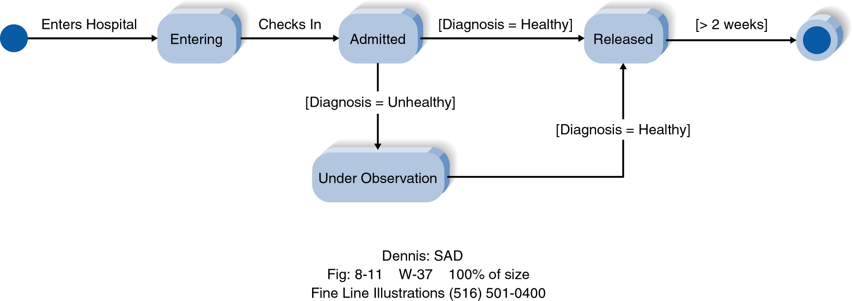
Example Behavioral State Machine Diagram

Slide 51
Example of a Subway Turnstile (1)
If the turnstile is in the Lock state, and a Coin event occurs
The turnstile transitions to the Unlocked state
The Unlock action is performed
If the turnstile is in the Unlock state, and a Pass event occurs
The turnstile transitions to the Locked state
The Lock action is performed

Slide 52
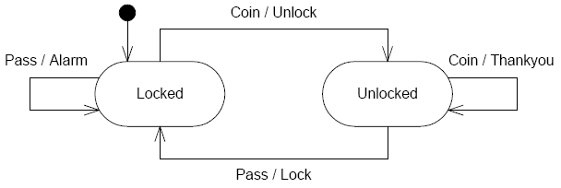
Example of a Subway Turnstile (2)
Modeling abnormal events
When a user passed through in the Locked state
When a user deposits another coin in the already unlocked state

Slide 53
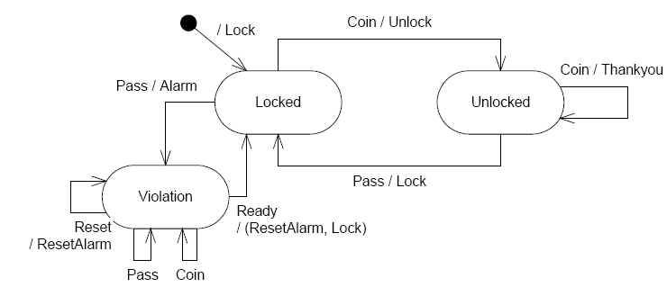
Example of a Subway Turnstile (3)
Handling abnormal events with the Violation state in detail

Slide 54
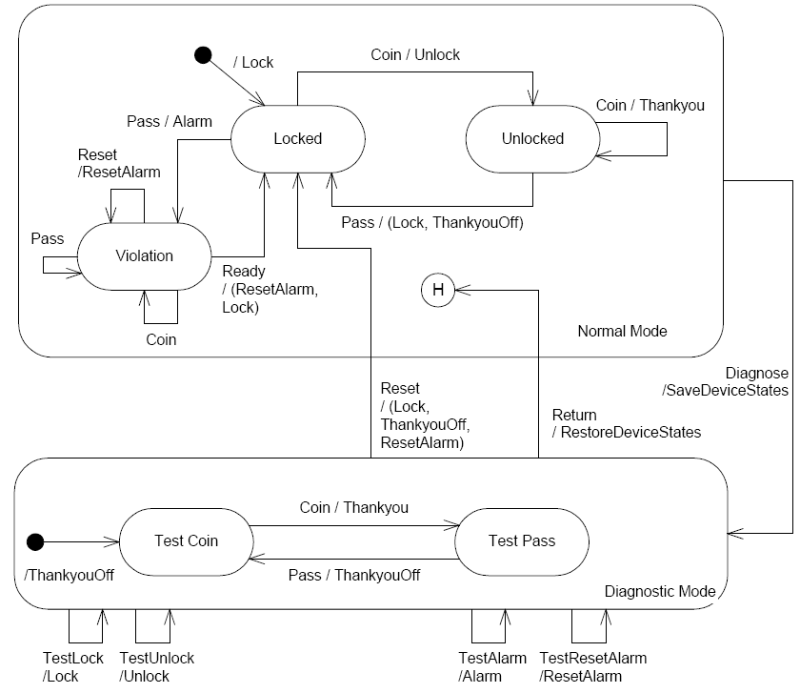
Example of a Subway Turnstile (4)
Modeling the Diagnostic Mode

Slide 55
Pseudostate
Name | Notation | Meaning
Initial / final |  | The default & final state of a composite state
deepHistory shallowHistory |  | The most recent active configuration of the composite state
fork/join |  | split and merge the transitions
junction |  | Chain together multiple transitions
choice |  | Dynamic conditional branch
entryPoint |  | An entry point of a state machine
exitPoint |  | An exit point of a state machine
terminate | X | The execution is terminated
H*
H
X

Slide 56
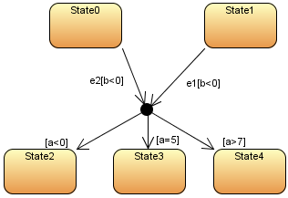
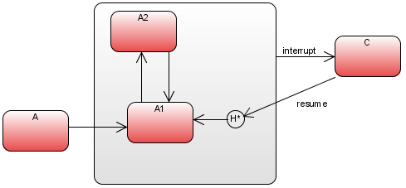
Example of Pseudostate

Slide 57
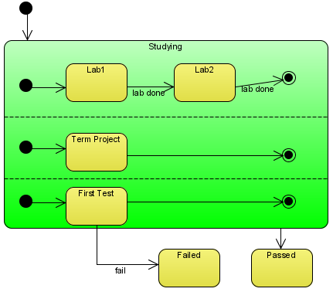
Composite state and regions
Composite state
represent Hierarchical state modeling internal structures
Region
represent concurrent states

Slide 58
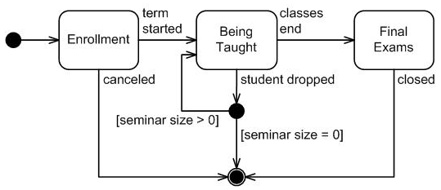
SM Example for Seminar lifecycle I

Slide 59
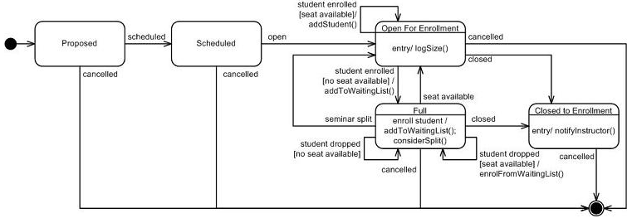
SM Example for Seminar lifecycle II
Refinement of Enrollment State

Slide 60
State Machine Example 1

Slide 61
Summary
Sequence diagrams illustrate the classes that participate in a use case and the messages that pass between them.
Collaboration diagrams provide a dynamic view of the object-oriented system and accentuate message passing between collaborating actors and objects.
Behavioral State Machine diagrams show the different states that a single class passes through in response to events.

